Slide 1

What Is Cloud Computing?
Cloud computing is a type of Internet-based computing that provides shared computer processing resources and data to computers and other devices on demand. It is a model for enabling ubiquitous, on-demand access to a shared pool of configurable computing resources (e.g., computer networks, servers, storage, applications and services), which can be rapidly provisioned and released with minimal management effort.

Slide 2
characteristics of Cloud Computing
1. RESOURCES POOLING
2. ON-DEMAND SELF-SERVICE
3. EASY MAINTENANCE
4. SCALABILITY AND RAPID ELASTICITY
5.MEASURED AND REPORTING SERVICE
6. SECURITY
7. AUTOMATION
8. RESILIENCE
9. LARGE NETWORK ACCESS
10. MULTI-TENANCY

Slide 3
Cloud Model
Deployment Model
Private Cloud
Public Cloud
Hybrid Cloud
Service Model
IaaS - Entire DC on Cloud
PaaS
SaaS

Slide 4
IAAS
Advantages
An IaaS provider is responsible for the entire infrastructure (Storage,vm,Network,Security) , users are responsible for installing and maintaining apps and operating systems, as well as for security, runtime, middleware and data.
Highly scalable resources
Enterprise-grade infrastructure
Cost depends on consumption
Multitenant architecture, i.e. a single piece of hardware serves many users
The client gets complete control over the infrastructure
Easy to use due to the automated deployment of hardware
Disadvantages
Vendor outages make customers unable to access their data for a while
The need for team training to learn how to manage new infrastructure

Slide 5
Paas
Features
Allows for developing, testing and hosting apps in the same environment
Resources can be scaled up and down depending on business needs
Multiple users can access the same app in development
The user doesn’t have complete control over the infrastructure
Web services and databases are integrated
Remote teams can collaborate easily
Reduced amount of coding required
Allows for easy migrating to the hybrid cloud
Disadvantages
Compatibility of existing infrastructure (not every element can be cloud-enabled)
Dependency on vendor’s speed, reliability and support

Slide 6
PAAS
The subscription model of utilizing
No need to download, install or upgrade software
Resources can be scaled depending on requirements
Apps are accessible from any connected device
The provider is responsible for everything
No hardware costs, No initial setup costs, Automated upgrades
Cross-device compatibility, Accessible from any location
Pay-as-you-go model, Scalability, Easy customization
Disadvantages
No freedom, you fully depend on the vendor
Connectivity is a must

Slide 7
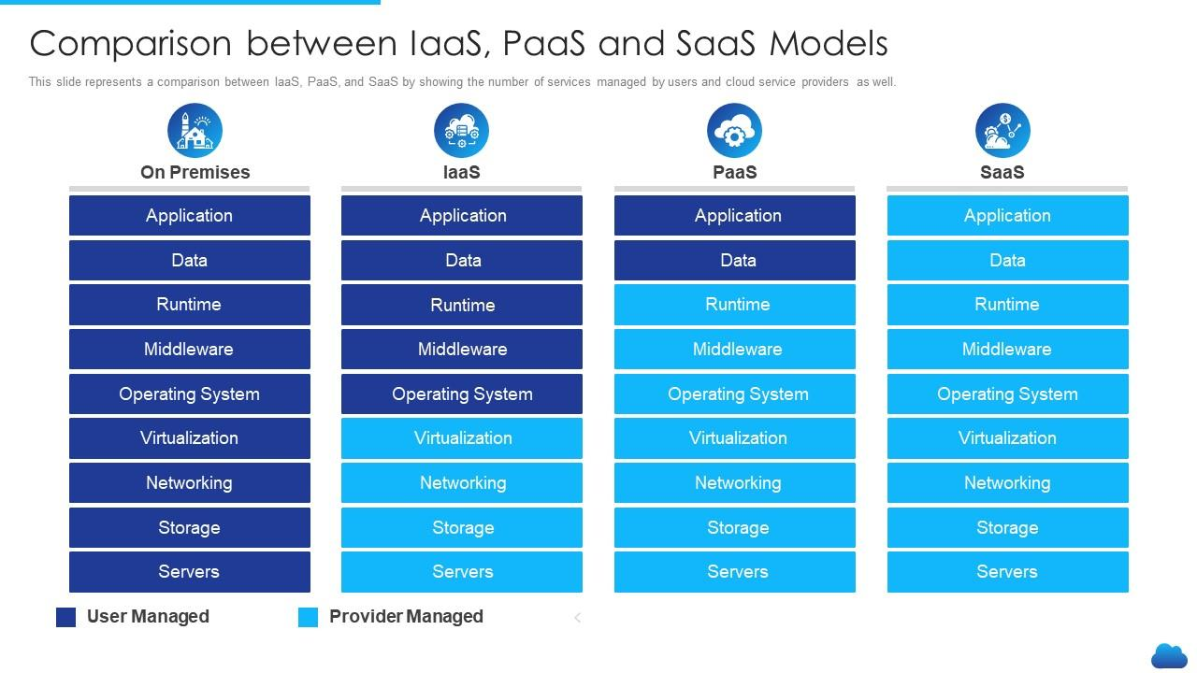

Slide 8
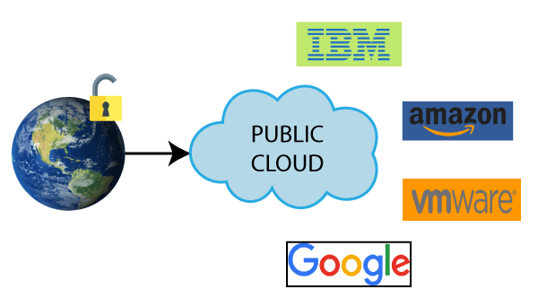
Public CLOUD
Public cloud is highly scalable as per the requirement of computing resources.
It is accessible by the general public, so there is no limit to the number of users.
Public cloud is maintained by the cloud service provider
It is accessible by the general public, so there is no limit to the number of users.
Public cloud is owned at a lower cost than the private and hybrid cloud.
Disadvantages of Public Cloud
Public Cloud is less secure because resources are shared publicly.
Performance depends upon the high-speed internet network link to the cloud provider.
Example: Amazon elastic compute cloud (EC2), IBM SmartCloud Enterprise, Microsoft, Google App Engine, Windows Azure Services Platform.

Slide 9
Cloud Providers
Amazon Web Services (AWS)
Microsoft Azure
Google Cloud
Alibaba Cloud
IBM Cloud
Oracle
Salesforce
SAP
Rackspace Cloud
VMWare

Slide 10
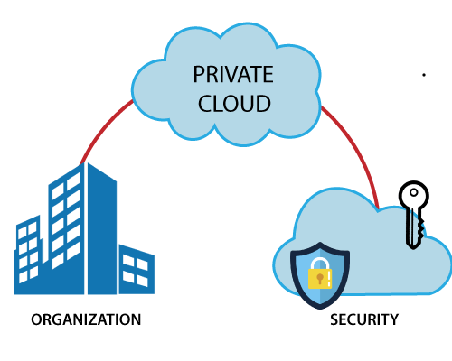
Private Cloud
Private cloud provides a high level of security and privacy to the users.
Private cloud offers better performance with improved speed and space capacity.
It allows the IT team to quickly allocate and deliver on-demand IT resources.
The organization has full control over the cloud
It is suitable for organizations that require a separate cloud for their personal use and data security is the first priority.
Disadvantages of Private Cloud
Private cloud is accessible within the organization, so the area of operations is limited.
Private cloud is not suitable for organizations that have a high user base
Example: HP Data Centers, Microsoft, Elastra-private cloud

Slide 11
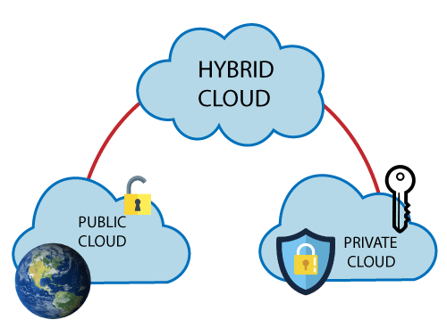
Hybrid cLOud
Hybrid cloud = public cloud + private cloud
In the Hybrid cloud, non-critical activities are performed by the public cloud and critical activities are performed by the private cloud.
Mainly, a hybrid cloud is used in finance, healthcare, and Universities.
Hybrid cloud costs less than the private cloud. It helps organizations to save costs for both infrastructure and application support.
Hybrid cloud provides an excellent way for companies to manage the risk.
Hybrid cloud helps you to deliver new products and services more quickly.
Disadvantages
Managing a hybrid cloud is complex because it is difficult to manage more than one type of deployment model.
In the hybrid cloud, the reliability of the services depends on cloud service providers.
Example: Google Application Suite (Gmail, Google Apps, and Google Drive), Office 365 (MS Office on the Web and One Drive), Amazon Web Services.

Slide 12
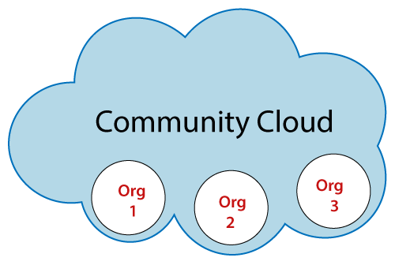
Community Cloud
Advantages
It provides better security than the public cloud.
It provides collaborative and distributive environment.
Community cloud allows us to share cloud resources, infrastructure, and other capabilities among various organizations.
Disadvantages
The fixed amount of data storage and bandwidth is shared among all community members.
Community Cloud is costly than the public cloud.
Sharing responsibilities among organizations is difficult.
Example: Health Care community cloud

Slide 13
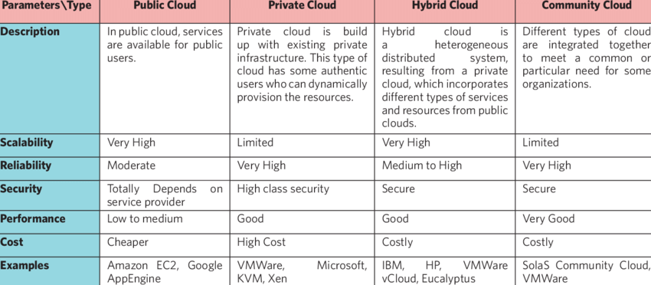
Types Of CLOUD

Slide 14
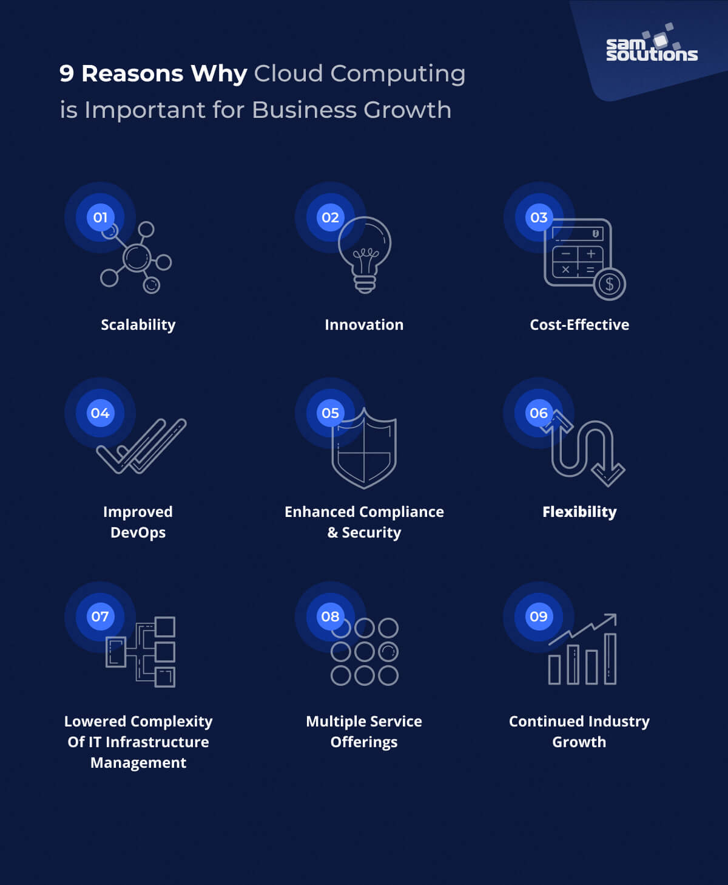
Why cloud computing is important to your business.,

Slide 15
Basics of Cloud security models,
Security controls—which can include technologies and processes. Controls should take into account the location of each service—company, cloud provider, or third party.
Trust boundaries—between the different services and components deployed on the cloud
Standard interfaces and security protocols—such as SSL, IPSEC, SFTP, LDAPS, SSH, SCP etc.)
Techniques used for token management—authentication, and authorization
Encryption methods including algorithms like 128-bit AES, Triple DES, RSA.
Security event logging—ensuring all relevant security events are captured, prioritized, and delivered to security teams.

Slide 16
Key challenges in Cloud environments
1. Data Security and Privacy
2. Cost Management
3. Performance Challenges
4. Interoperability and Flexibility
5. High Dependence on Network
6. Lack of Knowledge and Expertise

Slide 17
Automation possibilities in cloud platform,
AWS CloudFormation: this tool mechanizes and sends resources into your AWS cloud infrastructure.
Terraform : Terraform is an open source tool by Hashicorp, which lets you build, modify and version Infrastructure as Code.
Puppet: Helps configure, model, and authorize infrastructure configurations. Works for all cloud variations, from computing to storage and further to systems networking resources at a large scale.
Kubernetes: A holder organization apparatus is known for scaling, automating deployment, and the management of compartment applications.
Ansible: Ansible is another configuration management product that is synonymous with IaC, developed by Red Hat
AWS Elastic Beanstalk: Elastic Beanstalk is an automation platform that lets you deploy applications developed with Java, .NET, PHP, Node.js, Python, Ruby, Go, and Docker, across EC2 instances

Slide 18
